Slide 2
Chapter 26
Banking, Saving, and Investing

Slide 3
Section 26.1
Banking

Slide 4
Objectives
Describe the features of different types of financial institutions.
Explain how electronic banking services work.
Describe how checking accounts may be used.
Describe the special types of checks that can be used in place of personal checks and cash.
Explain how safety-deposit boxes are used.

Slide 5
Key Terms
electronic funds transfer (EFT)
e-check
automated teller machine (ATM)
debit card
smart card
cash card
endorsement
canceled check
traveler’s check
cashier’s check
certified check
money order

Slide 6
Essential Question
What should be considered when choosing a bank?

Slide 7
Types of Financial Institutions
There are three common types of financial institutions.
Commercial banks
Savings and loan associations (S & Ls)
Credit unions
A credit union differs from a commercial bank and an S & L in that its services are for members only.

Slide 8
Electronic Banking
Online banking allows you to use your computer to manage your finances through an Internet connection.
An electronic funds transfer (EFT) is the automatic transfer of money from one account to another electronically.
Using the telephone is another way to pay bills and transfer funds.
E-checks are an electronic version of a paper check can be used for online payments.

Slide 9
Electronic Banking (continued)
Automated teller machines (ATMs) are computer terminals that customers use to make financial transactions.
A debit card allows you to withdraw funds from your bank account and make purchases.
A smart card is an advanced type of debit card that contains a microchip.
A cash card is a prepaid type of debit card.

Slide 10
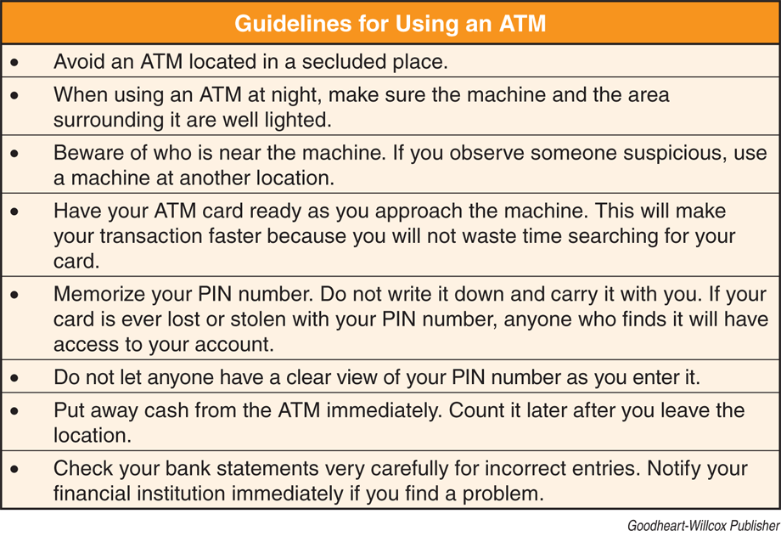
Electronic Banking (continued)

Slide 11
Checking Accounts
A checking account provides the following.
Safe place to keep cash
Easy way to withdraw cash
More secure way to send payments through the mail
Detailed record of spending and receipts
Method of establishing a credit history
Place where paychecks can be deposited directly

Slide 12
Checking Accounts (continued)
Financial institutions offer many types of checking accounts.
Some accounts pay interest.
Some accounts require a minimum balance.
Some accounts have a monthly fee associated with them.

Slide 13
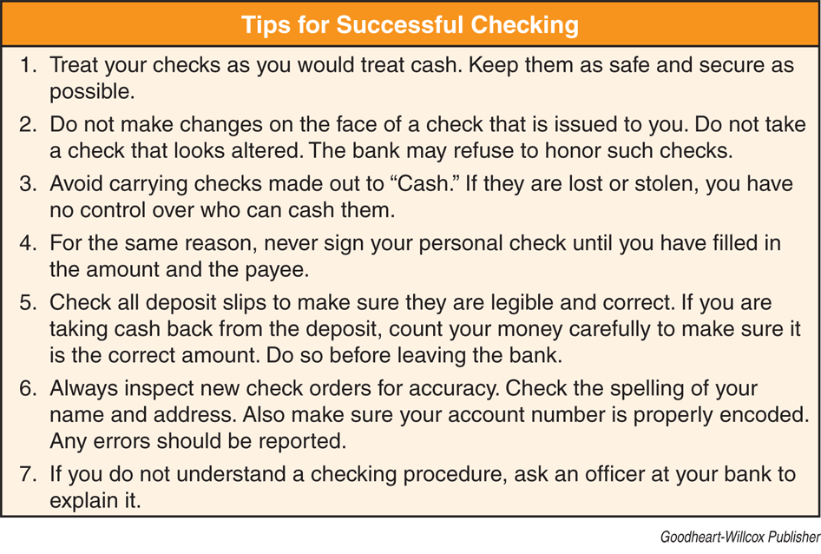
Checking Accounts (continued)

Slide 14
Checking Accounts (continued)
Making deposits
Fill out a deposit slip.
Record the amount of deposit into your register.
Money may not be available immediately.
Endorsing checks
An endorsement is the signature required on the back of a check to legally transfer value.
Blank endorsement
Restrictive endorsement
Special endorsement

Slide 15
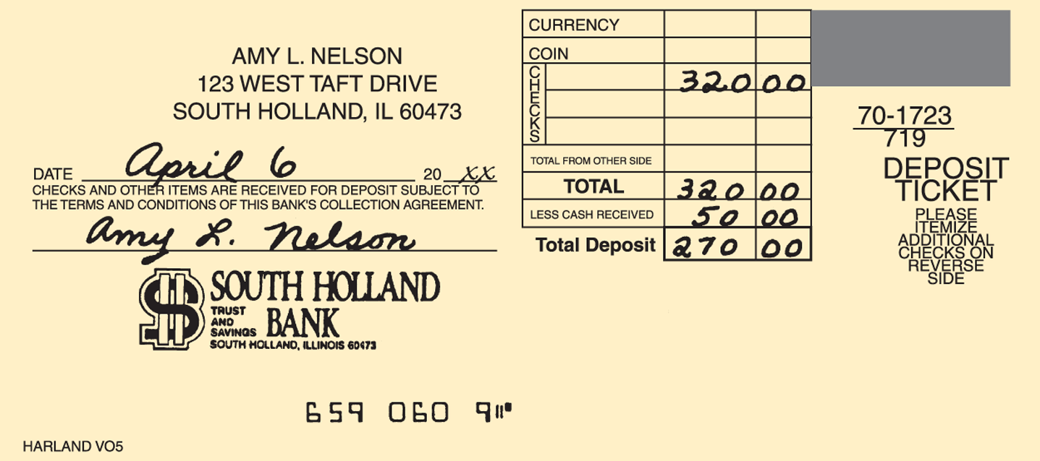
Checking Accounts (continued)
Goodheart-Willcox Publisher

Slide 16
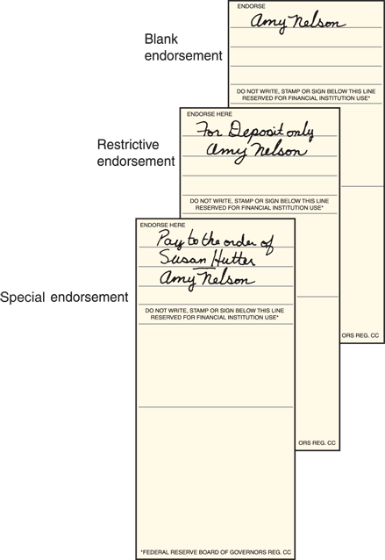
Checking Accounts (continued)
Goodheart-Willcox Publisher

Slide 17
Checking Accounts (continued)
Writing checks
Date
Name of the payee
Amount of the check in numerals
Amount of the check in words
Purpose of the check
Signature

Slide 18
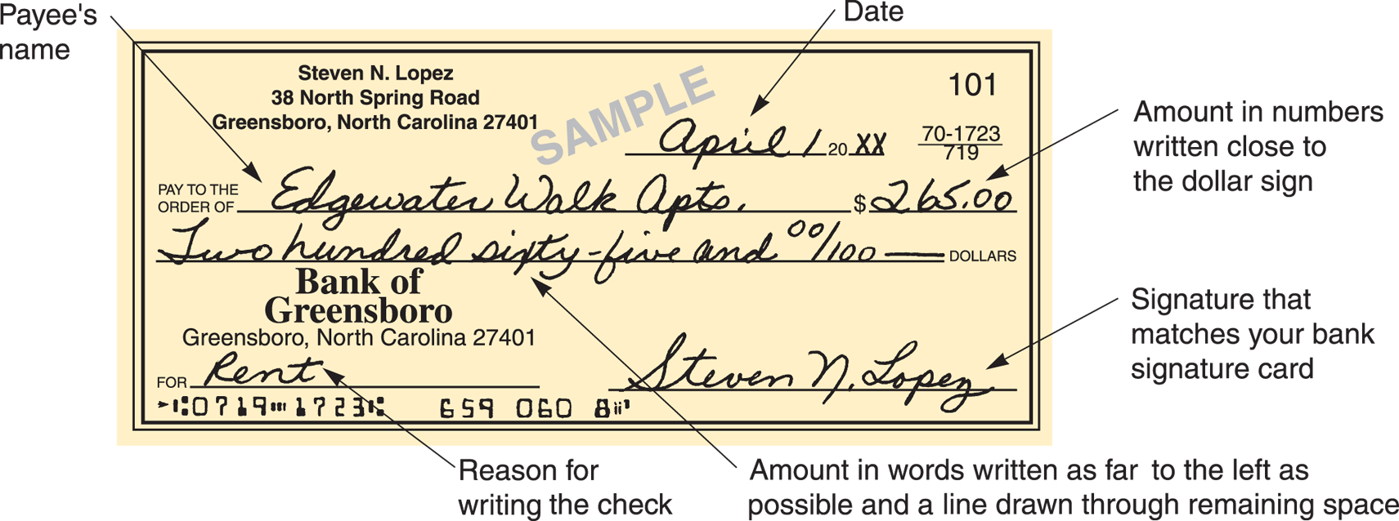
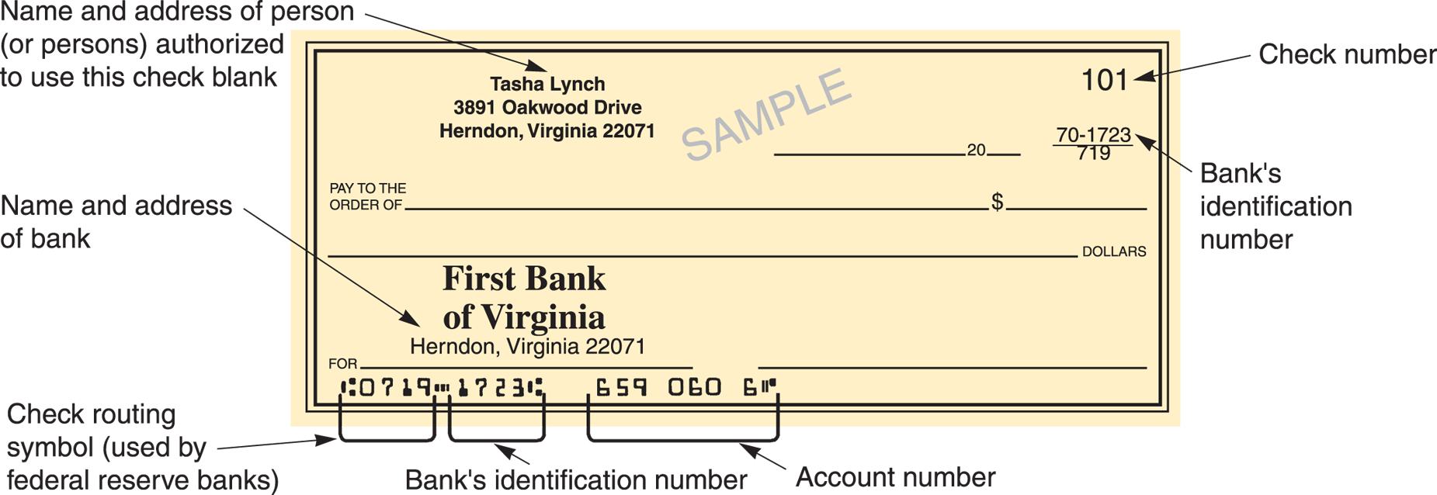
Checking Accounts (continued)
Goodheart-Willcox Publisher

Slide 19
Checking Accounts (continued)
Record changes to your account
Update register each time funds enter or leave account.
For check transactions, include check number, date, payee, purpose, and check amount.
For debit card transactions, include date, name of the merchant or ATM location, purpose, and amount.
Keeping up-to-date records will help with balancing account.

Slide 20
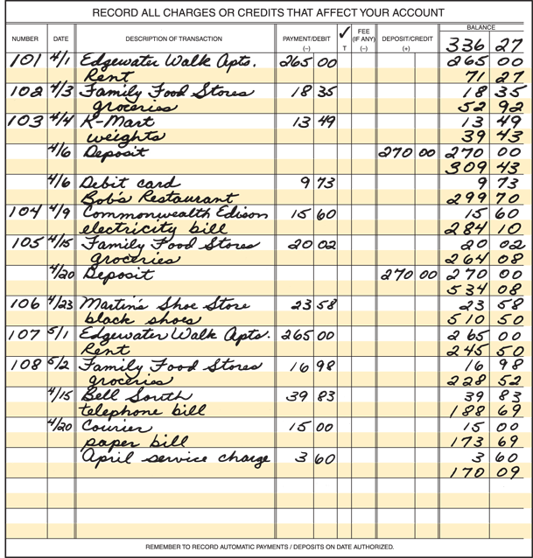
Checking Accounts (continued)
Goodheart-Willcox Publisher

Slide 21
Checking Accounts (continued)
Cashing checks
Many places ask for ID.
Do not endorse until in the presence of a bank teller.
Balancing a checkbook
Make sure your register agrees with the bank statement mailed to you.
Canceled checks are checks that have been processed by the bank.

Slide 22
Special Types of Checks
A traveler’s check is accepted as cash in most places around the world.
A cashier’s check is issued from a bank’s account rather than the account of a person or a business.
A certified check is a personal check with a bank’s guarantee that the check will be paid.
A money order is a type of check issued for a specific amount of money payable to a specific payee.

Slide 23
Safe-Deposit Boxes
Banks and some other financial institutions rent safe-deposit boxes in their vaults.
Safe-deposit boxes are small metal containers that people rent to protect their valuables from fire and theft.
It takes two keys to open a safe-deposit box: your key and one retained by the financial institution.

Slide 24
Review
1. List three factors to consider when choosing a financial institution.
Any three of the following: location; hours of operation; availability of online banking options; fees charged
2. List two advantages of online banking.
The convenience of using your computer to manage your finances and access to services 24-hours a day
3. What does direct deposit mean?
Automatically depositing paychecks directly into a checking or savings account each payday.

Slide 25
Review
4. List five guidelines for using an ATM safely.
Any five of the following: Avoid an ATM located in a secluded place; when using an ATM at night, make sure the machine and the area surrounding it are well lighted; beware of who is near the machine; have your ATM card ready as you approach the machine; memorize your PIN number; put away cash from the ATM immediately; check your bank statements very carefully for incorrect entries; keep your car doors locked and your engine running when using a drive-up ATM.

Slide 26
Review
5. How does a debit card differ from a cash card?
A purchase made using a debit card deducts money from a checking or savings account where a purchase made using a cash card deducts money previously loaded onto the card.

Slide 27
Section 26.2
Saving and Investing

Slide 28
Objectives
Explain the types of savings products available to financial institutions.
Compare different types of investments.
Describe ways to invest wisely.

Slide 29
Key Terms
simple interest
compound interest
certificate of deposit (CD)
inflation
Consumer Price Index (CPI)
securities
stock
bond
mutual fund
money market fund
401(k) plan
individual retirement account (IRA)

Slide 30
Essential Question
What is the most effective way to save money?

Slide 31
Saving
Saving money in a financial institution provides a safe place to keep your money and pays interest.
Simple interest is interest paid only on the money initially deposited.
Compound interest is interest paid on the initial deposit plus any interest already earned.
A regular savings account allows you to make deposits and withdrawals in varying amounts at any time.

Slide 32
Saving (continued)
A money market deposit account pays a higher interest rate.
It may require a minimum balance.
The number and the amount of the checks allowed may be restricted.
A certificate of deposit (CD) pays a higher interest rate than a regular savings account.
A CD requires depositors to commit their money for a specific period.

Slide 33
Investing
Investments can be a good way to protect against inflation.
Consumer price index (CPI) is a measure of the average change in prices for consumer goods and services over time.
Most investments involve some degree of risk.
The three basic types of investments are securities, retirement accounts, and real estate.
Securities are financial instruments that represent ownership, indebtedness, or the rights to ownership.

Slide 34
Investing (continued)
A stock is a share in the ownership of a corporation.
A bond is a certificate of debt issued by a corporation or a government.
In a mutual fund, money from a number of investors is combined and invested in securities.
A money market fund is a type of mutual fund that deals only in high interest, short-term investments.

Slide 35
Investing (continued)
A 401(k) plan is a retirement savings plan offered through an employer.
An individual retirement account (IRA) is a type of savings account that anyone with earned income can open as a way to save for retirement.
Traditional IRA charges tax on earnings and withdrawals after retirement.
Roth IRA taxes contributions, but not withdrawals or earnings after retirement.

Slide 36
Investing Wisely
Investing can be very risky.
Do not invest money you cannot afford to lose.
Be sure you have an emergency fund in place before investing.
Research the current outlook for the economy.
Look for an investment that is expected to increase in value.
Make sure you understand the risks and rewards of the investment.

Slide 37
Review
1. What is the difference between simple interest and compound interest?
Simple interest is only applied to the initial amount invested while compound interest pays interest on the interest earned.
2. Why do corporations and governments issue securities?
To get money to operate and expand.
3. List five types of investments.
Stocks, bonds, retirement accounts, mutual funds, and real estate.

Slide 38
Review
4. What is the difference between a bond and a stock?
A bond is like an IOU, and stock indicates partial ownership.
5. When should an individual start saving for retirement?
When he or she gets her first job.

